Slide 1
Cookbook for Practice 5.1
实践5.1攻略
Cong Li 李聪

Slide 2
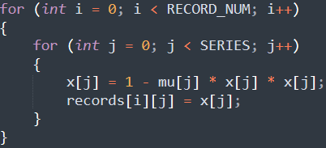
No Records 去除记录 (1)
Duplicate ‘pipeline.cpp’ as ‘scan.cpp’
将’pipeline.cpp’复制为’scan.cpp’
For simplicity in a large number of series, we remove the result recording capability & therefore delete the related code
简化数列非常多的情况，我们去除记录结果能力，故删除相关的程序

Slide 3
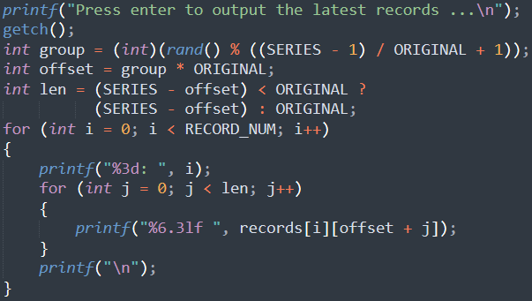
No Records 去除记录 (2)
Continue deleting 继续删除

Slide 4

Small Changes 小改动
Allow ‘STEPS’ to be defined in compilation
允许编译时指定’STEPS’
Loop over all the steps (no recording now)
循环所有的迭代步数（现在不作记录了）

Slide 5
Compile & Run It 编译并运行之
Compile & run w/ different configurations
编译并运行不同的配置
mingw32-make SRC=scan.cpp NATIVE=1 EXTRA_CXXFLAGS="-DSERIES=65536 DSTEPS=80000" -B
run-scan.exe
Configuration | SERIES | STEPS
1 | 32 | 163840000
2 | 1024 | 5120000
3 | 65536 | 80000
4 | 524288 | 10000

Slide 6
The End

